Slide 1
U.S. ENERGY
Jess Khine
William Huang

Slide 2

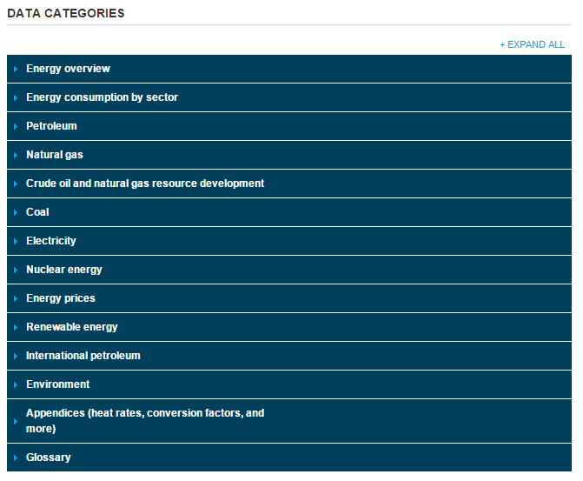
EIA.gov
U.S. ENERGY INFORMATION ADMINISTRATION
Monthly Energy Review
1976-2014
Renewable Energy
Solar
Geothermal
Hydroelectric
Wind
Biodiesel
Biomass
Ethanol
Notes:
Geothermal - is thermal energy generated and stored in the Earth
Hydroelectric – is energy generated from falling water or running water
Biodiesel - a form of diesel fuel manufactured from vegetable oils, animal fats, or recycled restaurant greases. It is safe, biodegradable, and produces less air pollutants than petroleum-based diesel.
Biomass - energy generated from combustion of biological material derived from living, or recently living organisms. It most often refers to plants or plant-based materials
Ethanol - is a renewable fuel made from corn

Slide 3
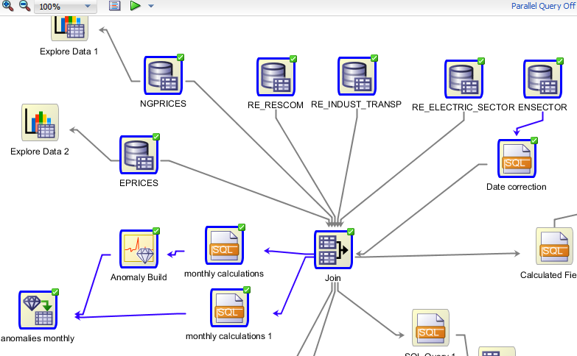
Anomaly Detection Workflow

Slide 4
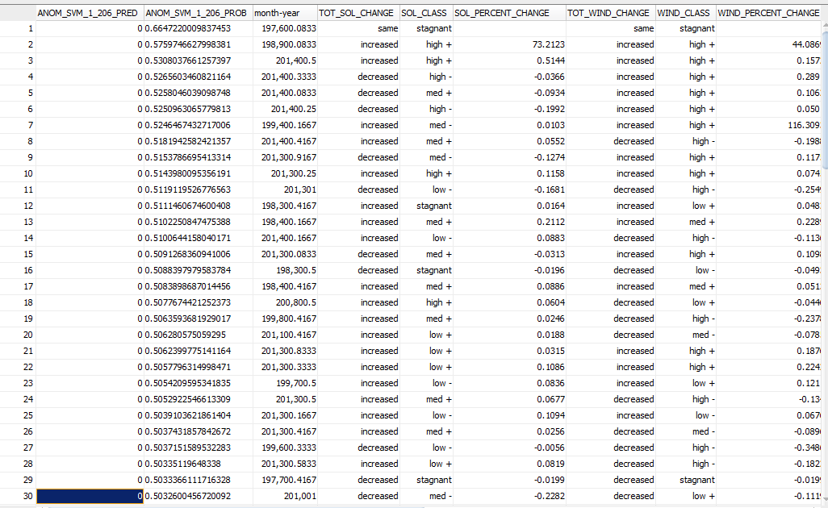
Anomaly detection
Notes:
Talk about percent change

Slide 5
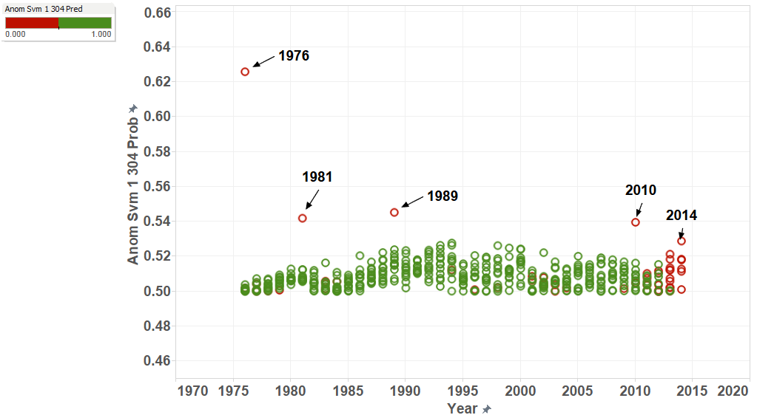
Tableau: Anomalies
Notes:
Data mining concepts
The distance from the center of a normal distribution indicates how typical a given
point is with respect to the distribution of the data. Each case can be ranked according
to the probability that it is either typical or atypical.
SVM – Support Vector Machine

Slide 6
1976
First year recorded

Slide 7
Tableau: Anomalies
Notes:
Data mining concepts
The distance from the center of a normal distribution indicates how typical a given
point is with respect to the distribution of the data. Each case can be ranked according
to the probability that it is either typical or atypical.
SVM – Support Vector Machine

Slide 8
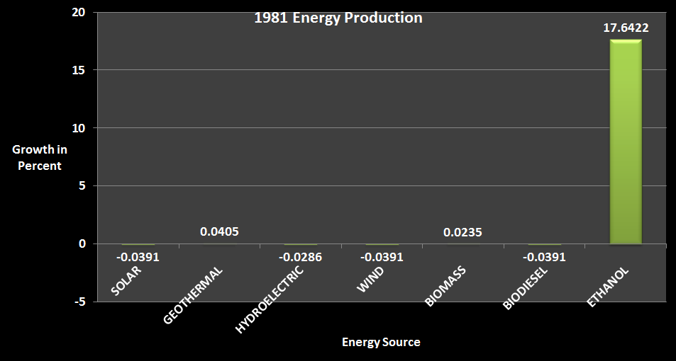
1981
Chart of 1981 Energy Production (All Sources)
Notes:
High Ethanol Percent Growth

Slide 9
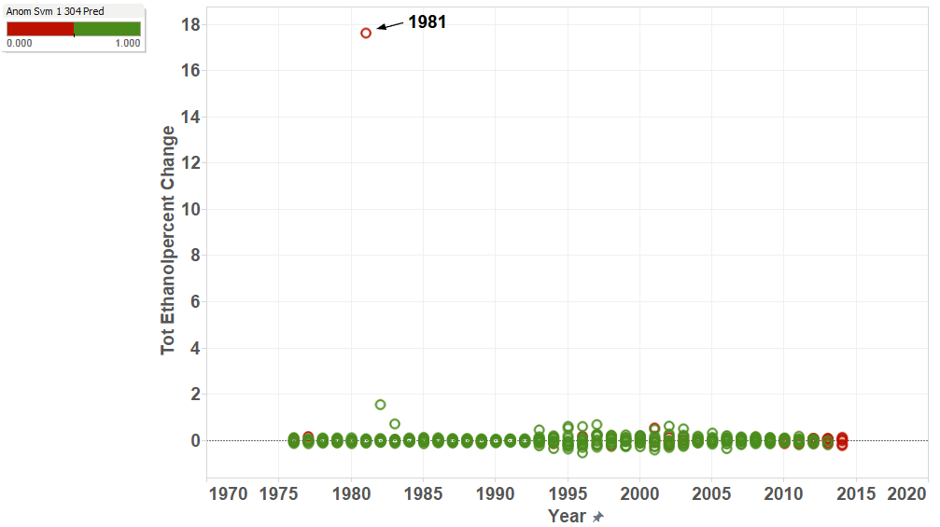
1981
Ethanol First Recorded 1976
Chart of Ethanol Percent Change with Anomalies

Slide 10
Tableau: Anomalies
Notes:
Data mining concepts
The distance from the center of a normal distribution indicates how typical a given
point is with respect to the distribution of the data. Each case can be ranked according
to the probability that it is either typical or atypical.
SVM – Support Vector Machine

Slide 11
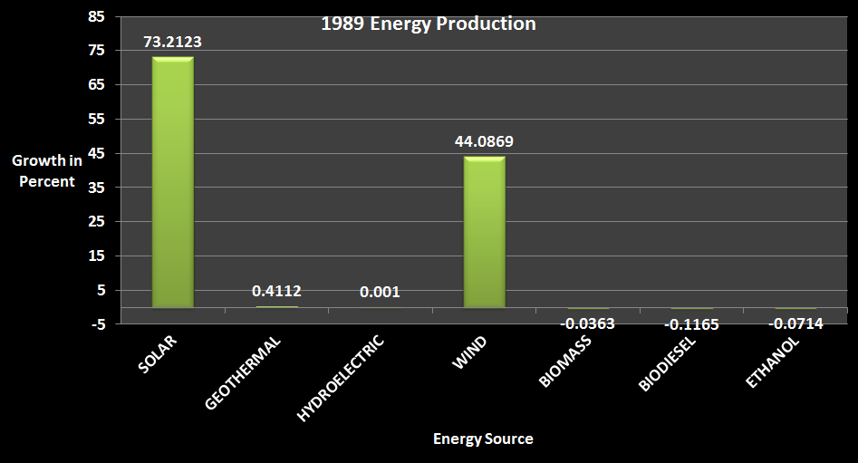
1989
Large Solar and Wind Percent Growth
Chart of 1981 Energy Production (All Sources)
Notes:
Looking at Solar and Wind anomalies will show interesting things later

Slide 12
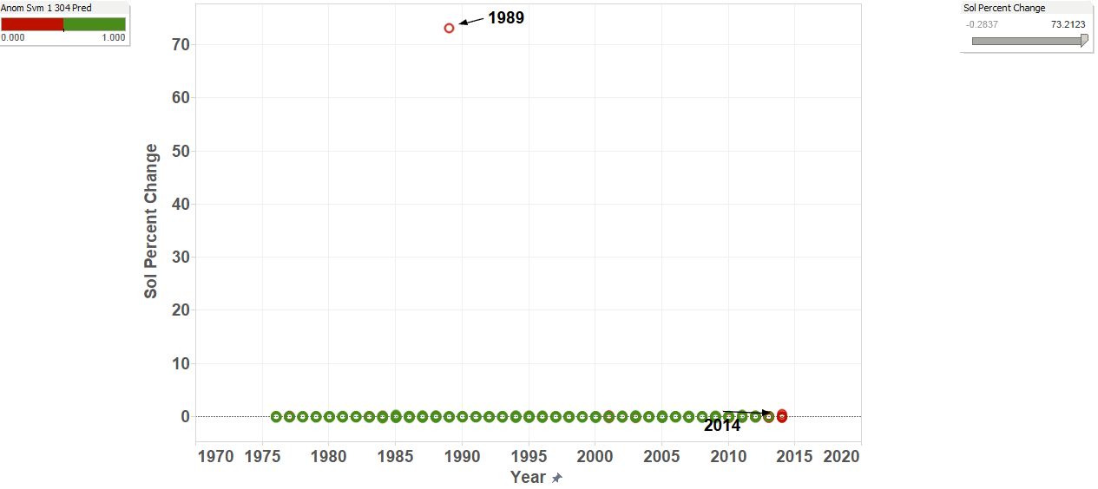
1989 Solar
Chart of Solar Percent Change with Anomalies

Slide 13
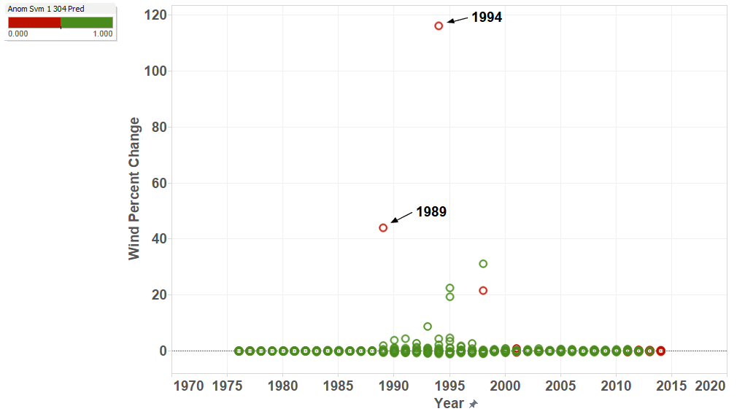
1989 Wind
Chart of Wind Percent Change with Anomalies
Notes:
Talk about 1994 later

Slide 14
Tableau: Anomalies
Notes:
Data mining concepts
The distance from the center of a normal distribution indicates how typical a given
point is with respect to the distribution of the data. Each case can be ranked according
to the probability that it is either typical or atypical.
SVM – Support Vector Machine

Slide 15
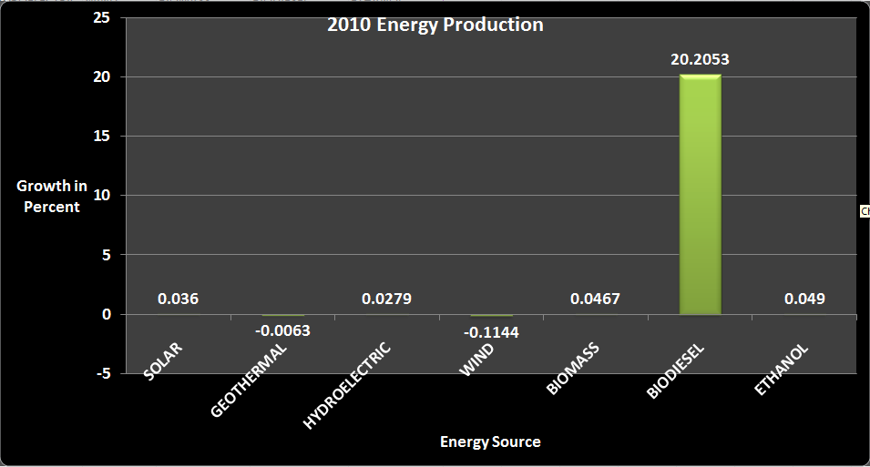
2010
Chart of 2010 Energy Production (All Sources)
Notes:
High Biodiesel Percent Growth

Slide 16
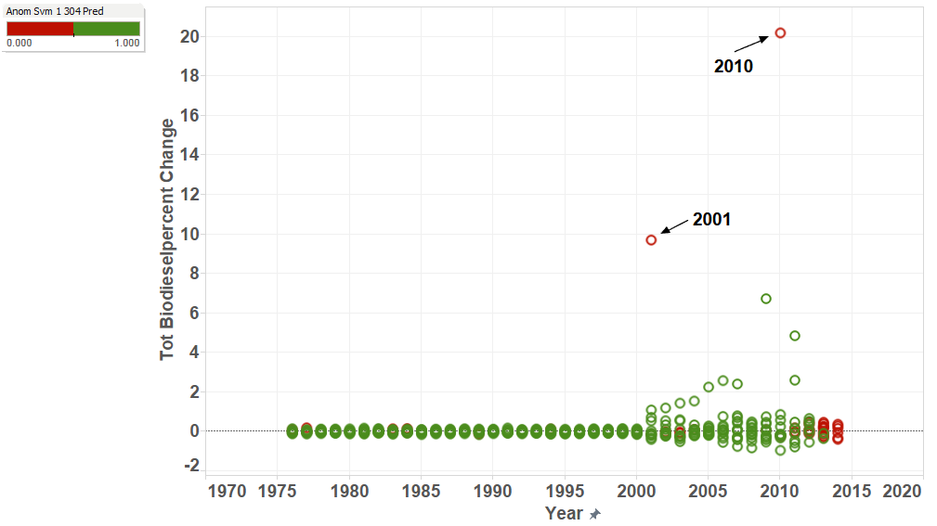
2010
Biodiesel First Recorded 2001
Chart of Biodiesel Percent Change with Anomalies

Slide 17
Tableau: Anomalies
Notes:
Data mining concepts
The distance from the center of a normal distribution indicates how typical a given
point is with respect to the distribution of the data. Each case can be ranked according
to the probability that it is either typical or atypical.
SVM – Support Vector Machine

Slide 18
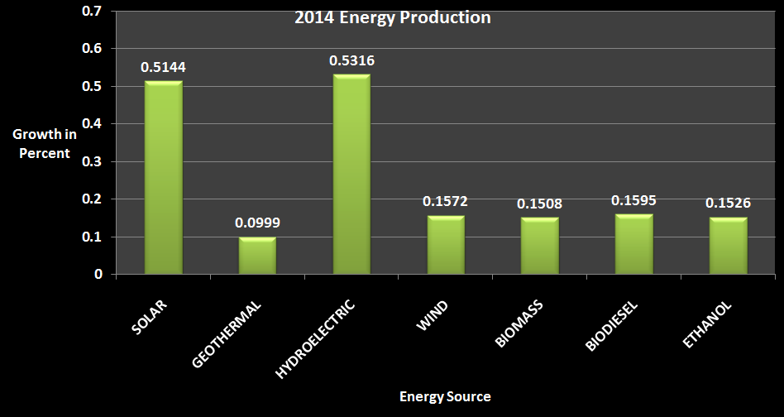
2014
End of Data
Chart of 2014 Energy Production (All Sources)

Slide 19
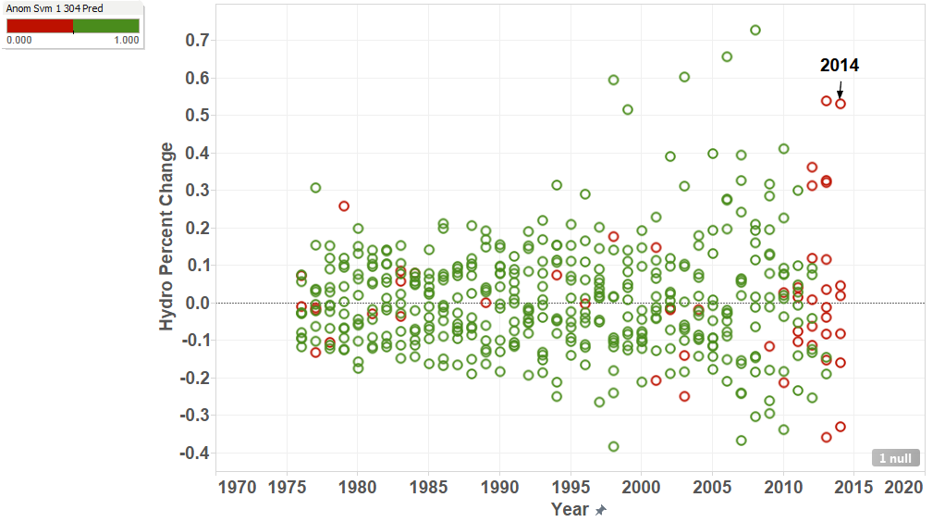
HYDROELECTRIC ANOMALIES
Chart of Hydroelectric Percent Change with Anomalies
Notes:
Hydro percent change not that drastic

Slide 20
Solar Anomalies
Skewed with 1989

Slide 21
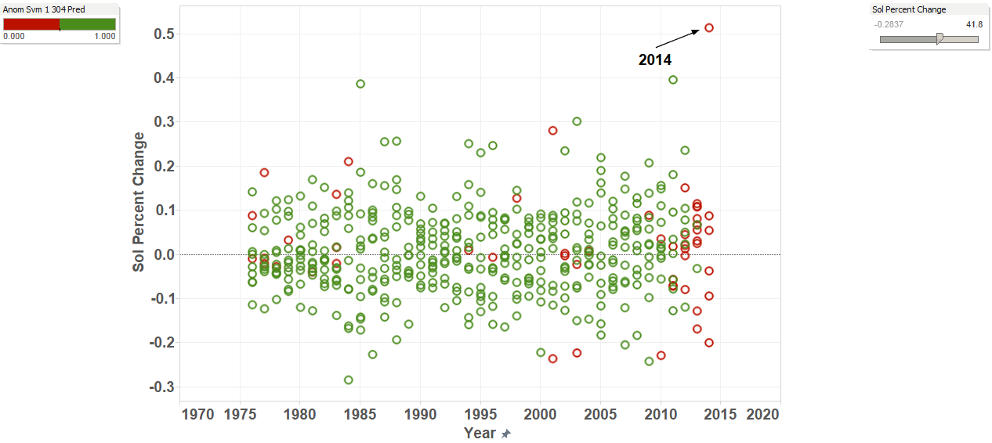
Solar ANOMALIES(FILTERED)
2014 Relatively High Percentage Growth

Slide 22
WIND ANOMALY 1994
Notes:
NO 1994

Slide 23
1994 Wind
Chart of Wind Percent Change with Anomalies

Slide 24
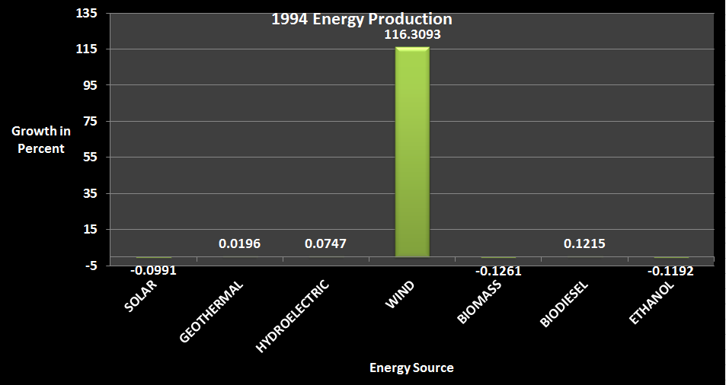
Wind Anomaly
Chart of 1994 Energy Production (All Sources)

Slide 25
Tableau: Anomalies
Notes:
NO 1994

Slide 26
Summary
1981: Ethanol Growth (17.64%)
1989: Solar Growth (73.21%) & Wind Growth (44.09%)
1994: Wind Growth (116.31%)
2010: Biodiesel Growth (20.21%)
Follow-up
Energy Prices
Energy Subsidies
World Events
Other Factors
Notes:
Explain growth

